Slide 1




Hybrid Log Classification System for Real Time Software Monitoring and Issue Detection
Abdullah Abid
UET, Pakistan

Slide 2

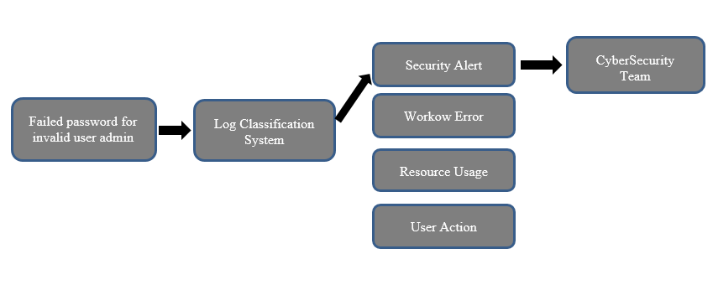


PROJECT OVERVIEW
Hybrid Log Classification System
Classifies system logs from CRM, HR, and billing software in real time
Uses regex rules, BERT ML model, and LLM for accuracy & coverage
FastAPI backend for easy integration with monitoring tools
Detects issues early, speeds up debugging, and improves security
.

Slide 3

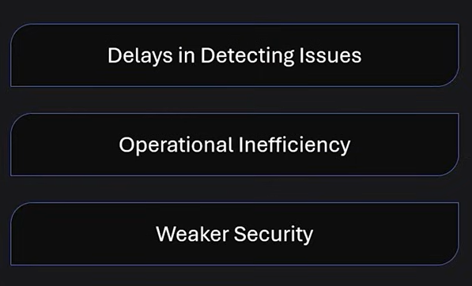
PROBLEM STATEMENT
Business applications (CRM, Billing, HR) produce large amounts of logs.
Logs contain mixed, unstructured messages.
Manual review is time-consuming and prone to human error.
Critical alerts can be missed without timely detection.
Need automated classification for faster, accurate log analysis.

Slide 4
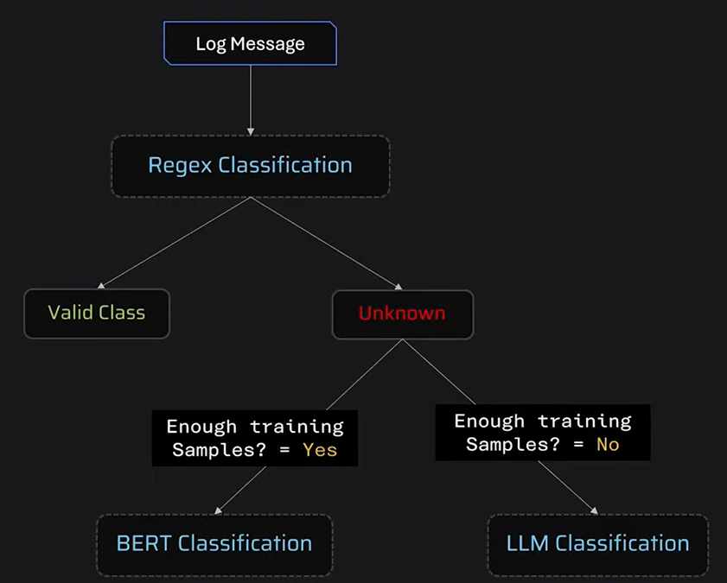

METHODOLOGY
This system uses a hybrid approach combining rule-based, machine learning, and LLM-based techniques for accurate log classification
.
First, logs are preprocessed and cleaned.
Regex-based classification is applied for fixed pattern logs, followed by BERT-based models using Sentence Transformers and Logistic Regression for logs with sufficient data.
For rare or unseen logs, LLaMA-based LLM classification is used with few-shot prompting.
The architecture integrates these components into a FastAPI backend that accepts log files, classifies them, and returns categorized results for integration with monitoring tools.

Slide 5
DATA COLLECTION AND PREPROCESSING
Before training, the dataset underwent the following preprocessing:
Text Cleaning
Removed extra quotes and escape characters.
Normalized spacing and punctuation.
Converted all text to lowercase to maintain uniformity.
EXCEL Preprocessing
Removed unnecessary columns and standardized column names to maintain consistency and clarity in the dataset.
Cleaned and formatted log messages by removing extra spaces, quotes, and special characters for better model readability.
Train-Test Split
Divided the dataset into training and testing sets to evaluate performance.

Slide 6

How it works:
First, the log messages are converted into numerical vector representations using a SentenceTransformer model (all-MiniLM-L6-v2), which captures the semantic meaning of the text.
Then, these embeddings are fed into a Logistic Regression model that learns to classify each log into the correct category based on training data.
This approach leverages powerful NLP embeddings for understanding log content, combined with a classic, efficient classification algorithm.
MODEL
DEVELOPMENT
Developed a log classification model that uses sentence embeddings combined with a Logistic Regression classifier to categorize system log messages into predefined labels like Security Alert, Workflow Error, System Notification, etc.
How it works:
First, the log messages are converted into numerical vector representations using a SentenceTransformer model (all-MiniLM-L6-v2), which captures the semantic meaning of the text.
Then, these embeddings are fed into a Logistic Regression model that learns to classify each log into the correct category based on training data.
This approach leverages powerful NLP embeddings for understanding log content, combined with a classic, efficient classification algorithm.

Slide 7
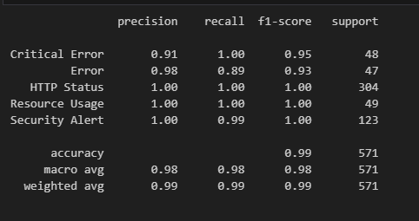
EVALUATION METRICS

Slide 8
RESULT AND IMPACT
Results:
The API successfully processed uploaded CSV log files and returned predicted categories, demonstrating practical usability.
The system handled real-world log message variations and noise well, thanks to robust embedding-based feature extraction.
Impacts:
Improved Efficiency: Automates the tedious task of manual log analysis, saving time for IT and security teams.
Faster Incident Response: Quickly identifies critical log entries like security alerts, enabling faster detection and mitigation of issues.
Better Monitoring: Structured log categorization supports more effective monitoring dashboards and alerts.
Scalability: The solution can scale to handle large volumes of logs, making it suitable for enterprise environments.

Slide 9
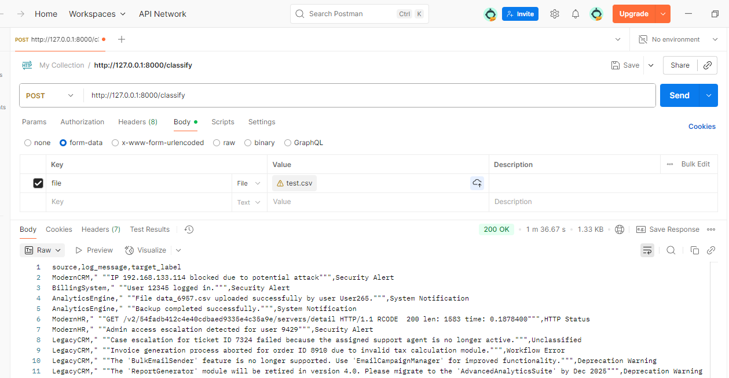
DEMO

Slide 10
CHALLANGES FACED
Challenges Faced:
Lack of Real-World Data: Obtaining a large, labeled dataset of real system logs was difficult, so we had to generate a synthetic dataset that realistically simulates diverse log messages and categories.
Data Noise and Variability: Log messages vary greatly in format, length, and content, often containing irrelevant tokens like timestamps, IPs, or user IDs that could confuse the model. Cleaning and preprocessing were essential to reduce noise.
Choosing the Right Model: Selecting an embedding model that balances accuracy and computational efficiency (e.g., all-MiniLM-L6-v2) and pairing it with a classifier like Logistic Regression required experimentation.
API Integration: Packaging the model into a robust, user-friendly API with proper error handling and file management took additional effort beyond model training.

Slide 11
SOLUTIONS
Solutions
Implemented Synthetic Dataset Generation: To overcome the lack of real-world labeled logs, we created a diverse synthetic dataset by simulating realistic log messages across multiple categories, ensuring balanced representation.
Comprehensive Preprocessing: We applied thorough cleaning steps like removing extra spaces, special characters, and irrelevant tokens to reduce noise and standardize inputs for better model learning.
Model Selection and Optimization: We chose a lightweight yet effective embedding model (all-MiniLM-L6-v2) for semantic feature extraction and paired it with Logistic Regression for efficient and accurate classification.
Robust API Development: The classification model was wrapped in a FastAPI-based service with input validation, error handling, and CSV file processing, enabling seamless integration and easy testing via tools like Postman.

Slide 12
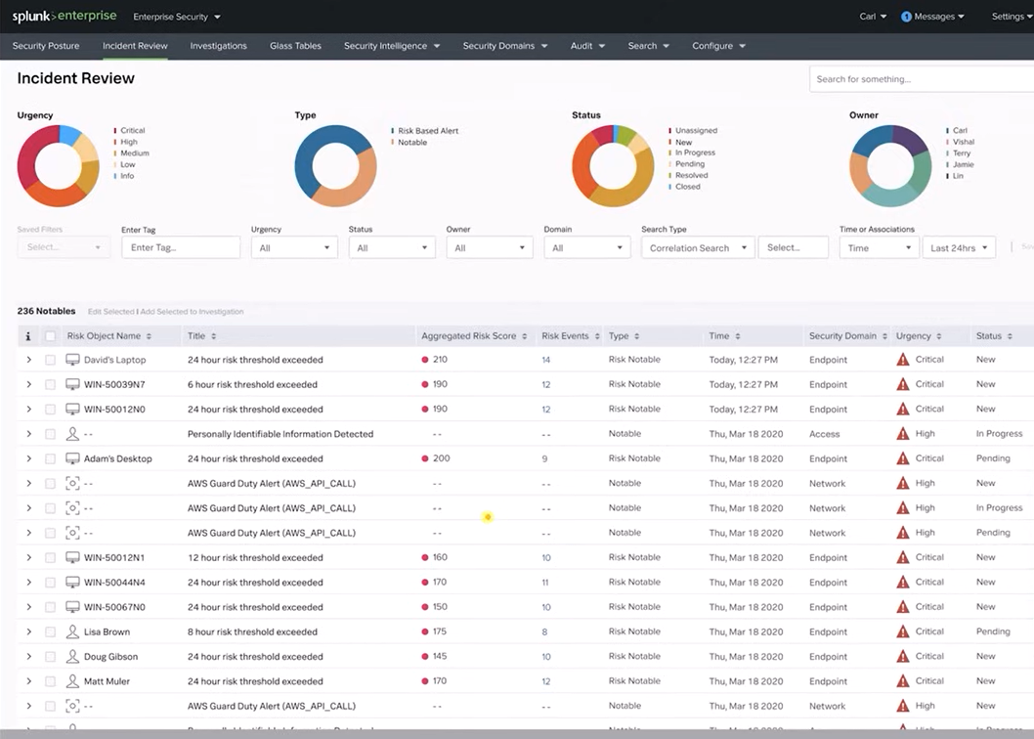
FUTURE WORK
Real-Time Monitoring System
Implement a live pipeline where incoming system logs are processed instantly, classified, and flagged if they indicate errors or security threats.
Can include automatic notifications via email, Slack, or SMS to alert administrators.
Anomaly Detection
Extend the system to detect unusual patterns in logs, such as sudden spikes in errors, suspicious activity, or rare events that don’t match normal usage patterns.
Useful for cybersecurity (detecting breaches), system health (catching hardware failures), and service uptime (preventing outages).
Examples of real-world services:
Splunk – widely used for real-time log monitoring and alerting.
AWS CloudWatch Anomaly Detection – uses machine learning to spot unusual metric behavior.

Slide 13
THANK
YOU

